Slide 1

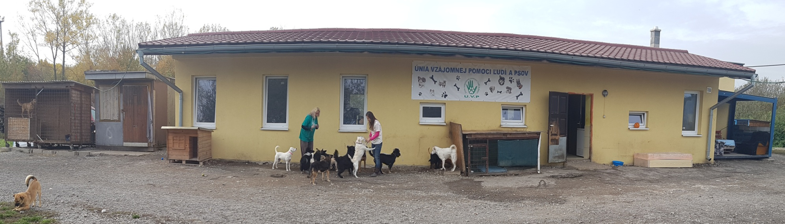
The Union of Mutual Help of People and Dogs (U.V.P.)

Slide 2
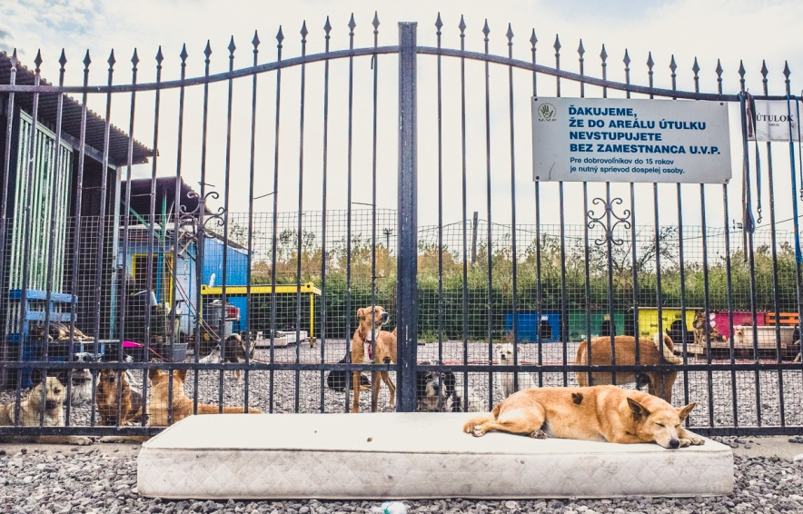
WHO WE ARE
The Union of Mutual Help of People and Dogs (U.V.P.) is a non-profit organization established in Košice (Slovakia) in 2001. Our mission is to save dogs` lives and provide them temporary homes till we find them loving and permanent homes. We have been working on fulfilling this mission through a number of activities:
- dog rescue, medical treatment and daily care
- spay/neuter programmes
- microchipping
- dog adoption and foster care programmes
- organising dog trainings
- public education including discussions and dog demonstrations at schools
- organising events promoting human animal treatment
- canistherapy
- cooperation with other shelters and non-sheltering human organisations in Slovakia
We apply the “no-kill” policy in our shelter.

Slide 3
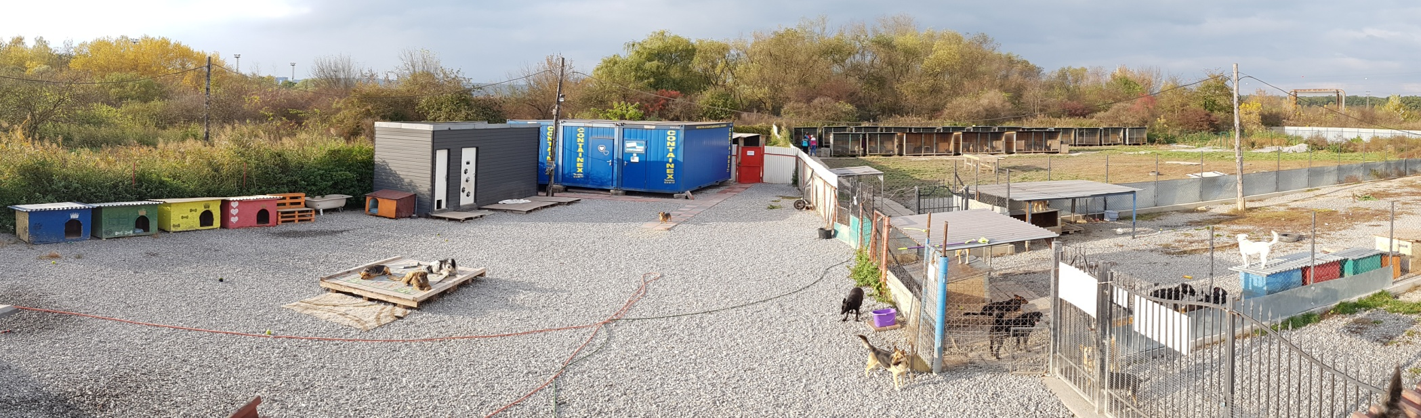
The shelter is located 15 km from the centre of Kosice (accessible by public transport), the second largest city in Slovakia (250,000 inhabitants). Our long term score is 200 dogs with about other 50 dogs in foster care. We have rescued more than 6,600 animals for last 15 years. All of them have been dewormed, vaccinated, neutered and microchipped while some of them had to be medically treated or even operated, too. Some dogs stayed one month, while others stayed for 1, 2 or 3 years or forever. Unfortunately, the number of stray dogs has been increasing during last few years resulting to the shelter having been permanently overcrowded, mainly due to irresponsible and careless dog owners.

Slide 4
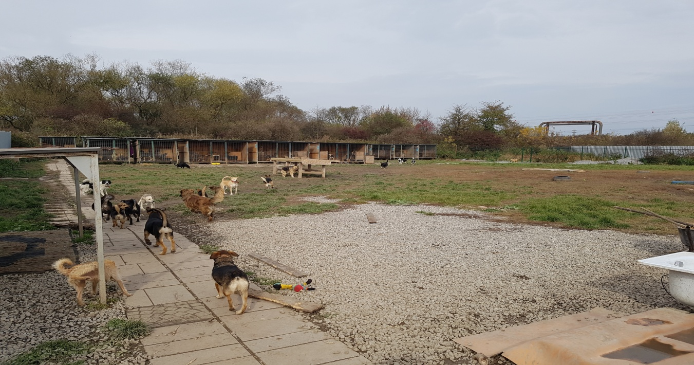
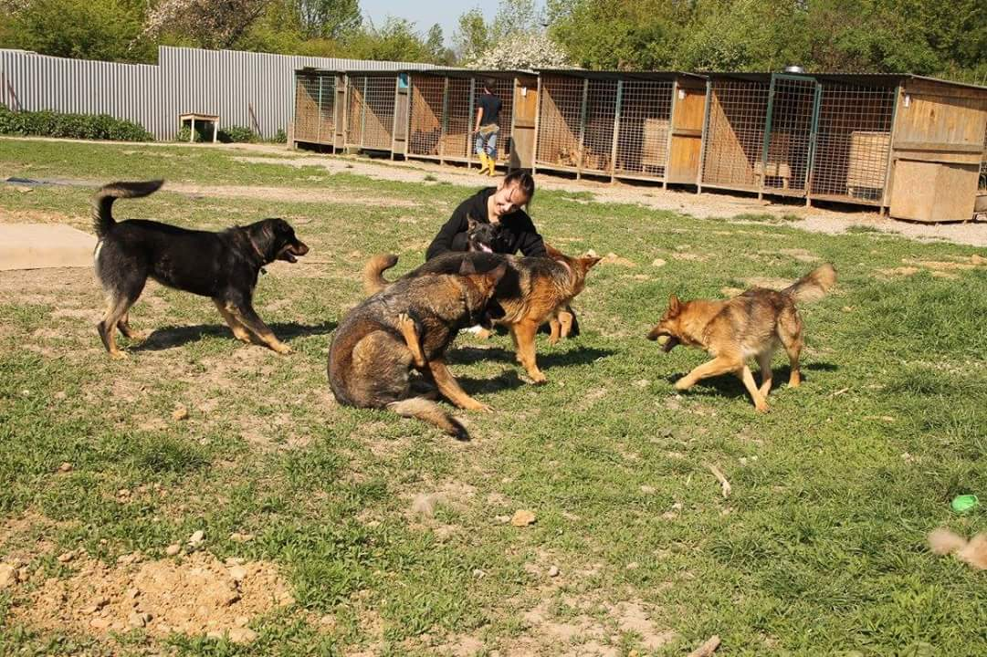
ANIMAL CARE
Every incoming dog is dewormed and washed, vaccinated, microchipped and neutered if meeting the age criteria. It is quarantined for minimum period of 28 days (Slovak regulatory requirement). Each dog in the shelter has to be registered and veterinary certificate has to be issued. This is regularly checked by the Slovak Regional Veterinary and Food Office. We apply „no-kill“ policy and euthanasia is accepted only if, according to the veterinary`s decision, the health conditions are incompatible with life.

Slide 5
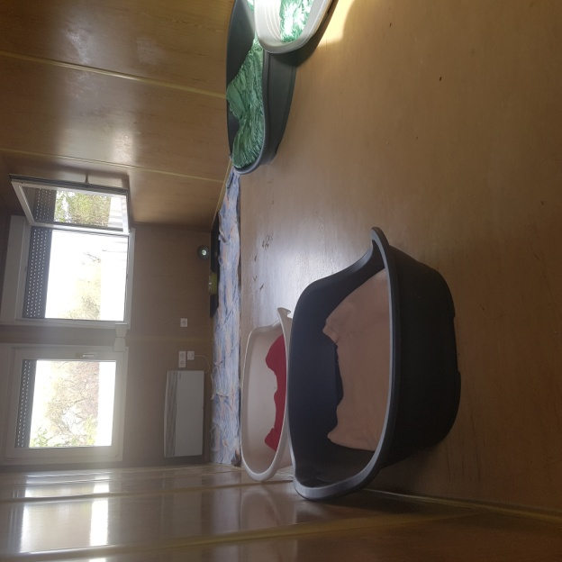
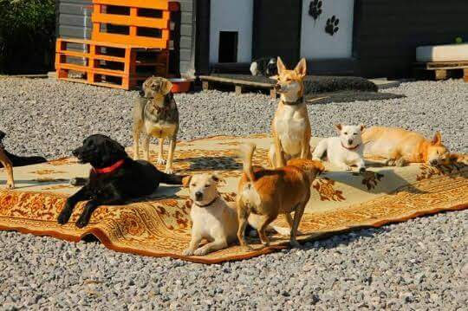
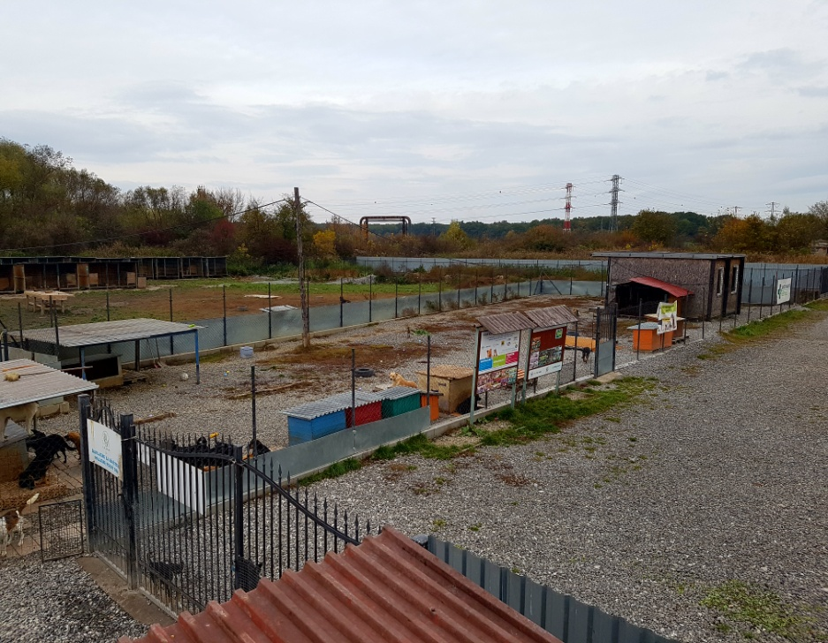
Dogs are separated after a time of quarantine by their size, age and ability to live in outdoor environment. Puppies, shorthaired dogs, dogs after surgeries or requiring special treatment live in a heated building with its own paddock. Large outdoor dogs live in kennels (by 2-3), all of them sharing one large paddock. The rest of dogs live in heated containers (by about 9 per a container according to their temperament and social behaviour). All animals have unlimited access to water. The food is cooked daily (mainly meat, rice, pasta and dog dry food) together with vitamins.

Slide 6
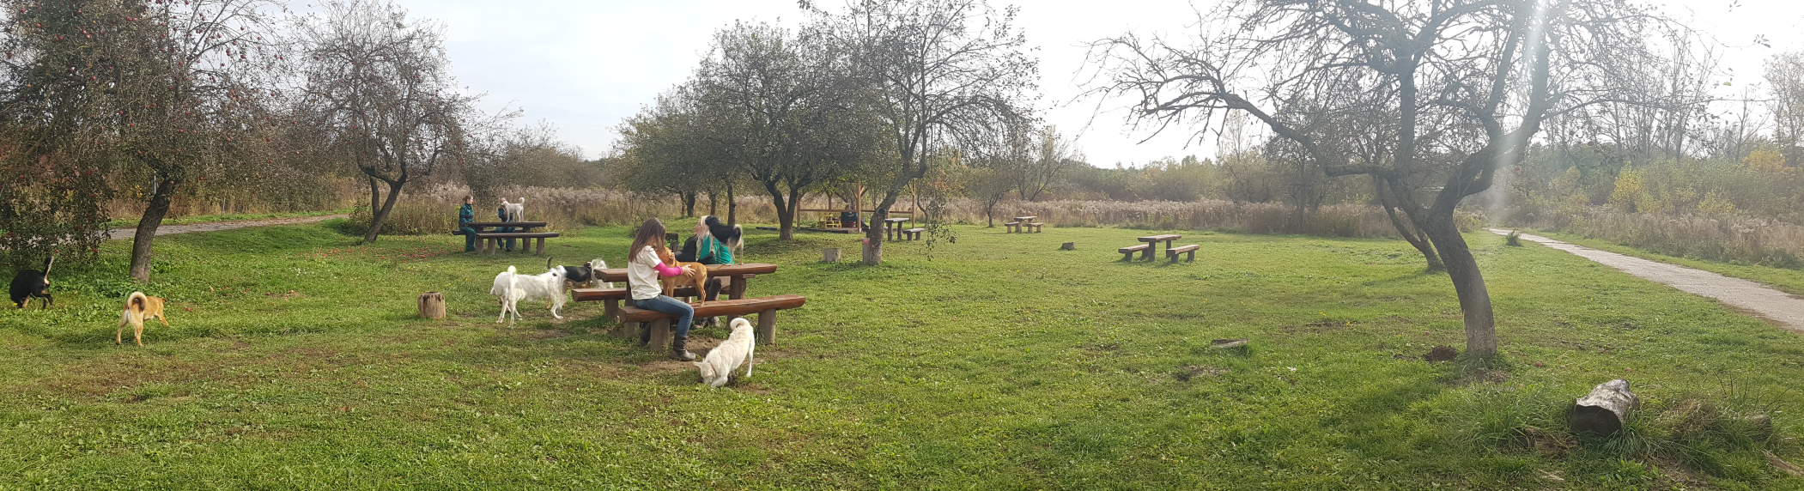
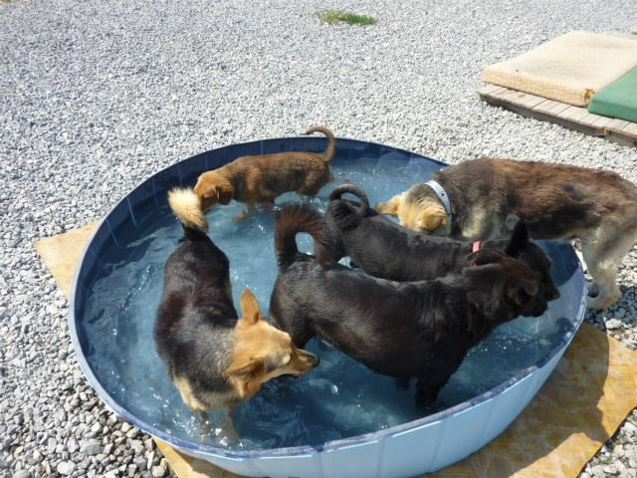
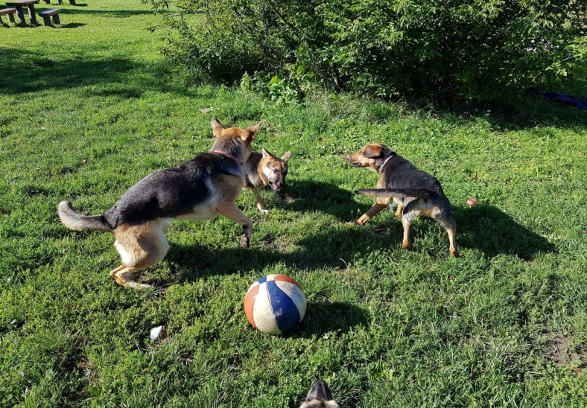
Our dogs are mostly street dogs, found as unwanted. Only 5% of our dogs are being searched for by their owners and are returned after providing us with the veterinary certificate and when we see an obviously positive feedback of the dog. Dogs stay in the shelter for six months on average. Volunteers assist us with daily individual dog walking and their socialization.

Slide 7
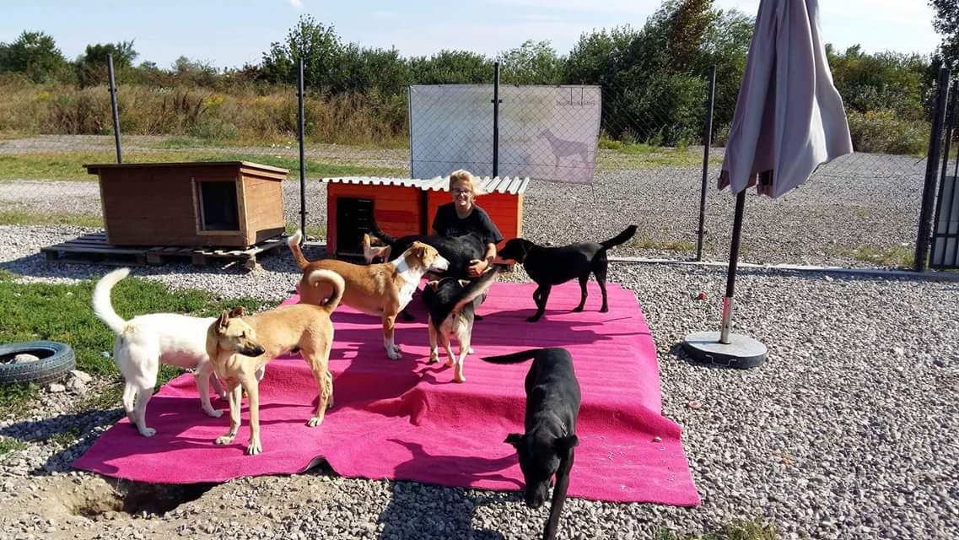
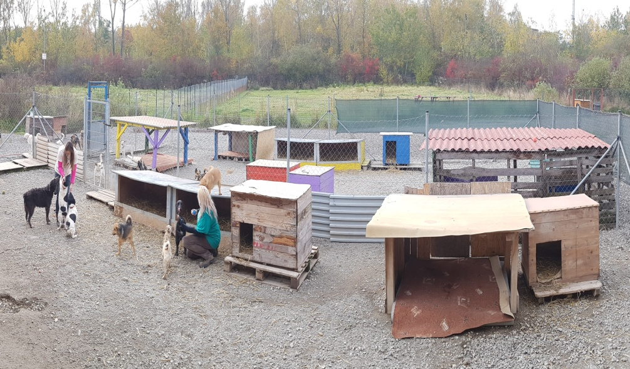
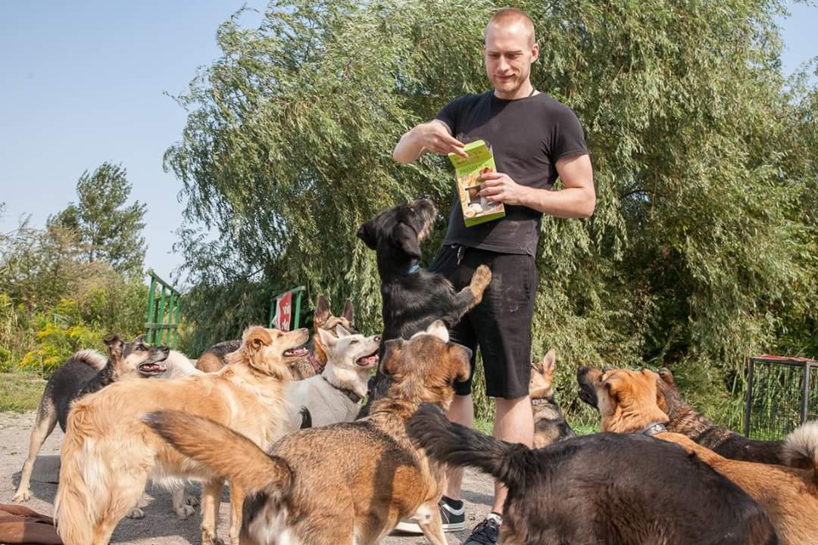
DOG ADOPTION PROCESS
Each potential adopter must pass a detailed interview focusing on living conditions, reason for adoption, experience and financial possibilities. A dog adoption is conditional on signing the adoption contract according to which an adopter commits him/herself to a proper dog care and provides his/her consent to an inspection of living conditions of the dog as well as to dog`s removal in case of any infringements of the adoption contract.

Slide 8
COOPERATION
City of Košice does not finance the shelter, however it is the guarantor on number of events organised by the shelter. The city has partially re-financed the veterinary and food costs of the shelter (once a year during recent years), but unfortunately to a very small extent given the large expenses of the shelter. However, the overall long-term cooperation with the city is very good and successful. The city, that is the owner of land where the shelter is located, rented the land for an indefinite period. In addition, part of a beautiful park in broader city centre owned by the city, has been rented to the shelter for the purpose of dog training to public. We have also agreement with the city on 50 % discount on tax of keeping the dog for dogs from the shelter.
U.V.P. intensively cooperates with a number of veterinary clinics and pet shops. Four veterinary surgeons have been contracted for a long time. Additionally, U.V.P. cooperates with schools and kindergartens to promote phylanthropy and education. As far as phylanthropy concerned the shelter organises material and financial collections while regular discussions and demonstrations are organised both at schools and shelter premises to promote education.
The shelter actively participates in projects „Do not buy, rather adopt!“ and „The animal is not an item“ organised within the whole of Slovakia and focused on stopping uncontrolled dog breeding and dog population.

Slide 9
COOPERATION
U.V.P. also cooperates with other shelters, non-profit organisations and volunteers looking for stray dogs within Slovakia. Adoption exhibition is organised annually together with all animal rescue organisations. Shelters help each other in case of critical situations by material help, animal placement, animal transportation, etc.
In 2009, U.V.P. started cooperation with a German non-profit organisation Internationaler Tierschutzverein Grenzenlos e.V. (ITV) that provided the financial support to the shelter to complete the construction of the heated building for a quarantine. Thanks to this organisation a few dogs from our shelter have found their new homes in Germany. ITV also financed the dog neuter projects in Roman settlements and villages as well as the neuter project of free living cats.
The shelter aslo cooperates with another German organisation, Tierschutzverein Lemuria e.V., that tries to help finding homes.
Although the shelter has been successfully operated for number of years, there are still many challenges how to improve living conditions of dogs in the shelter and dog adoption.

Slide 10
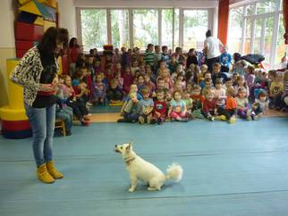
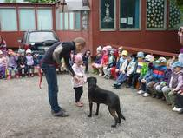
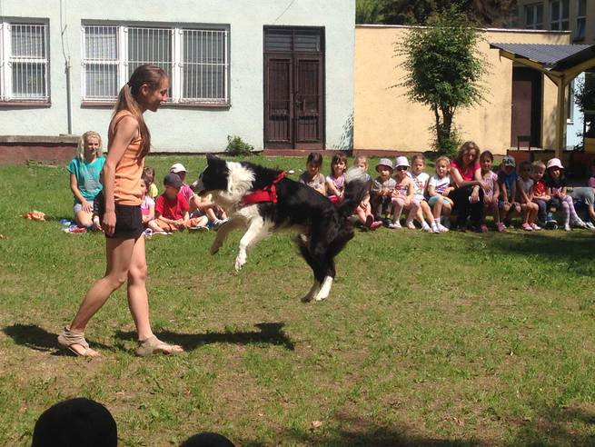
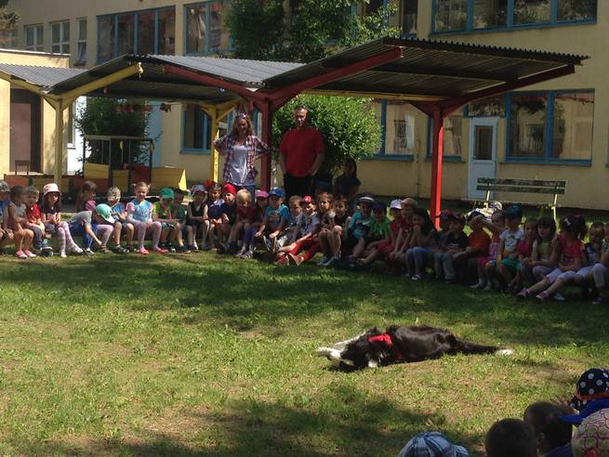
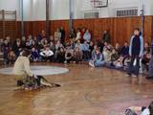
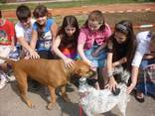
U.V.P. ACTIVITIES
Discussions at schools
Discussions at schools are organised weekly in the region of Košice and villages nearby. We explain the purpose of having a shelter, how to take care of a dog and what is animal abuse. We also demonstrate how to approach a strange dog or how to playfully teach a dog to obedience, even to a dog dancing.

Slide 11
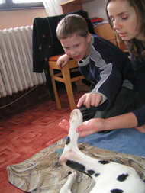
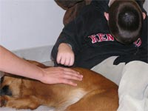
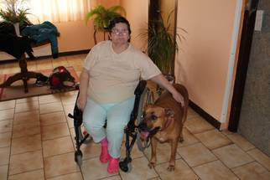
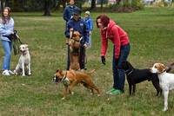
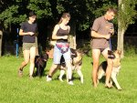
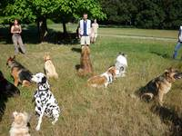
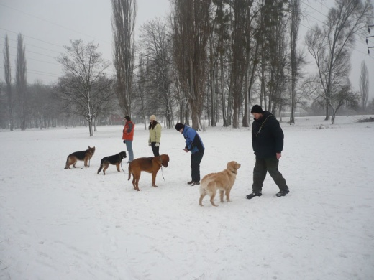
Canistherapy
U.V.P. has been pursuing canistherapy since 2005. We currently visit four organisations and one family with an authistic little girl.
Dog trainings for public
Dog trainings are aimed at eliminating problems (aggression, fear...), dog socialising, basic obedience, dog dancing and agility. We fully use a motivational method (great reward, consistency), while training itself is a game. Trainings are held in a large park near the city centre on Saturdays in three groups according to the level of training.

Slide 12
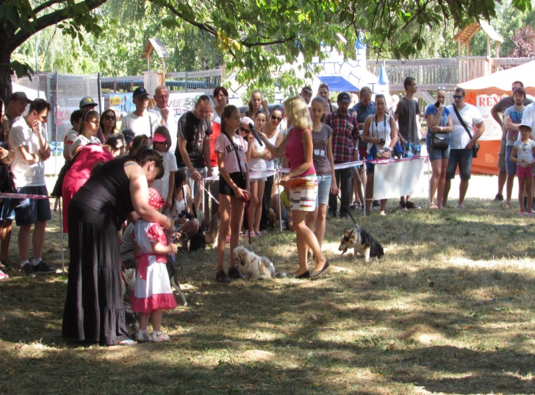
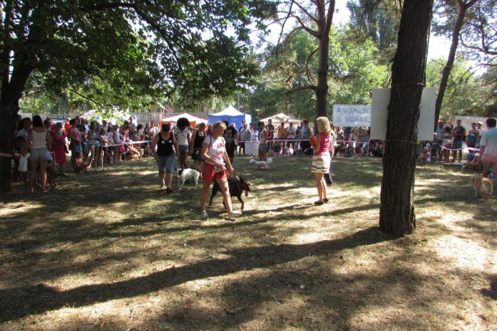
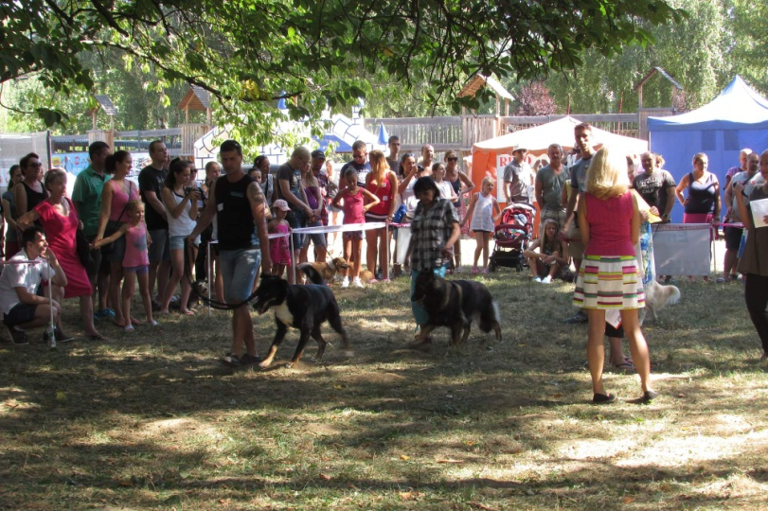
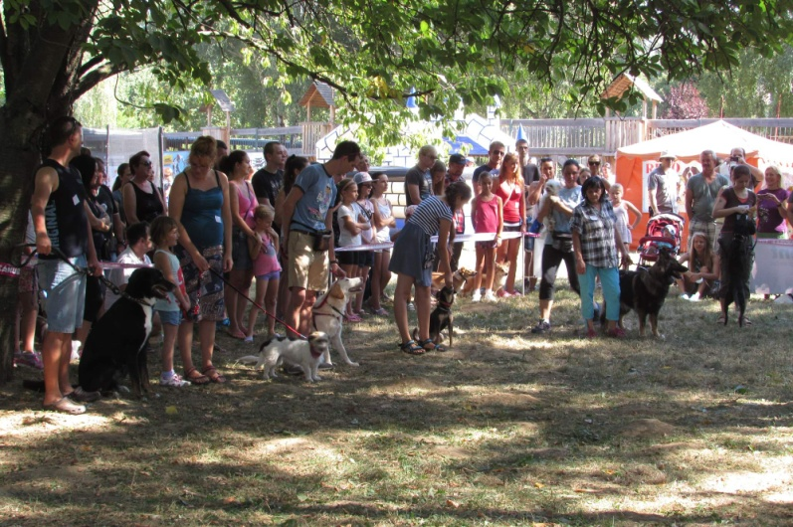
“Exhibition of non-pedigree dogs”
Annual exhibition of dogs without pedigree. Competitors compete in different categories, either crazy or those usually used at competitions of pedigree dogs. A number of competitions for children and adults, dog dancing shows, raffle with nice prices and lovely programme for children accompany the exhibition. Proceeds from the event goes to the account designated for the care of abandoned animals.

Slide 13
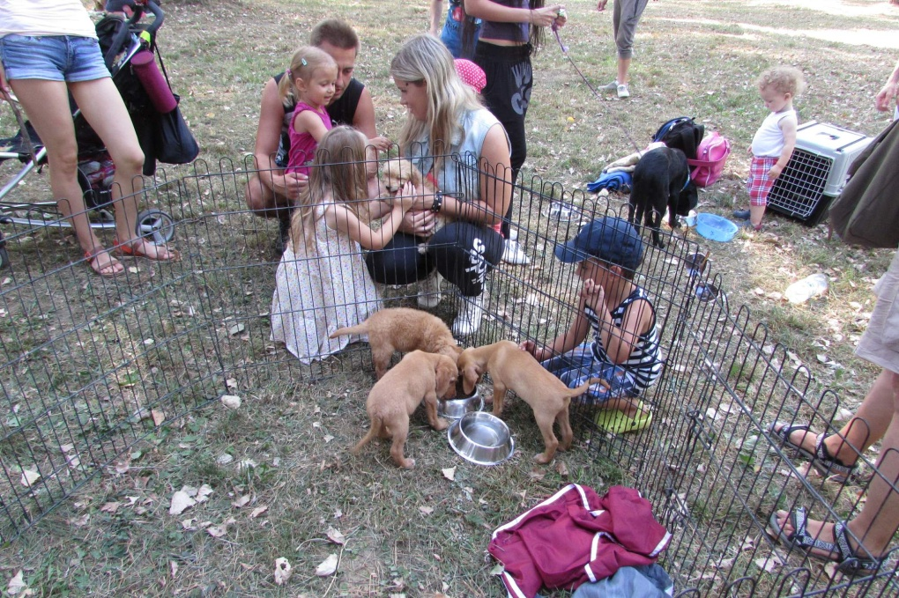
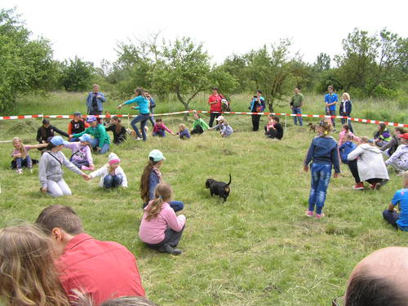
Open day at the shelter
Open day at the shelter is organised annually. The scope of the day includes a presentation of shelter`s running and discussions on animal welfare. The event is accompanied by a number of attractions for children and a range of activities for volunteers.
Kid`s day at the shelter
This day is full of interesting events and competitions for children. Discussions, dog demonstrations and dog dancing are not missing. Children are one of our main target groups that we tend to educate in the field of animal welfare.

Slide 14
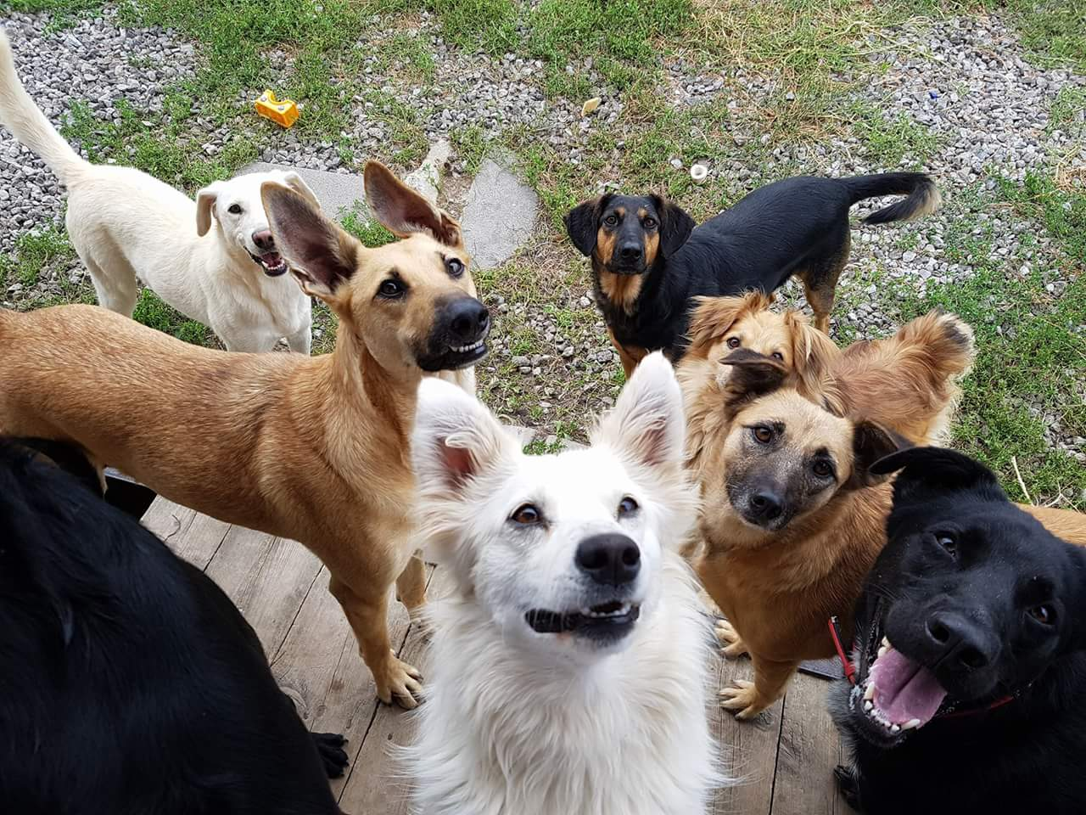
Contact:
Únia vzájomnej pomoci ľudí a psov, UVP
(The Union of Mutual Help of People and Dogs (U.V.P.) )
Oštepova 3, 040 01 Košice, Slovakia
Tel.: +421 905 671142, +421 907 441447
E-mail: uvp@uvp.sk Web: www.uvpl.sk (new website under development)
Facebook: Útulok UVP Košice
IČO: 35536438
DIČ: 2021572971
Bank: Slovenská sporiteľňa, a.s.
Name of bank account:
Únia vzájomnej pomoci ľudí a psov
IBAN: SK 4509000000000443423053 / 0900
BIC: GIBASKBX

